Slide 1
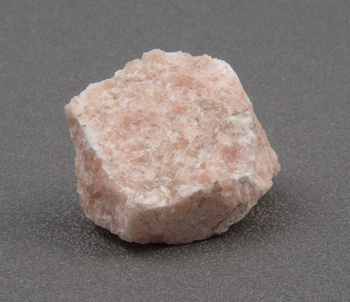
4 ~ 4 Metamorphic Rocks happen because of 1.heat (but not enough to cause melting), 2. pressure and/or 3.chemical reaction
marble

Slide 2
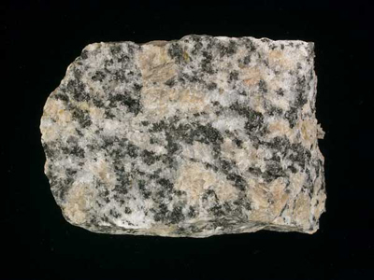
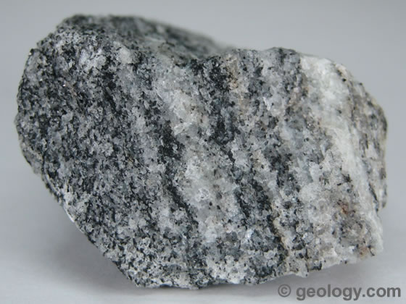
How do the grain patterns of granite (igneous) and gneiss (metamorphic) compare?
DEEP within the crust, some granite becomes gneiss. What do you think must happen to cause this change?

Slide 3
How Metamorphic Rocks Form?
HEAT (100-800°C)--not enough to melt the rock
and/or PRESSURE (hundreds or thousands of times stronger than at the surface)
happens deep inside Earth (12-16 km)
appearance, texture, crystal structure, and mineral content changes
can form from any other type of rock, including another metamorphic rock

Slide 4
How metamorphism happens
1--if rock is near magma
2--deep underground
3--where tectonic plates collide {may uplift the area}

Slide 5
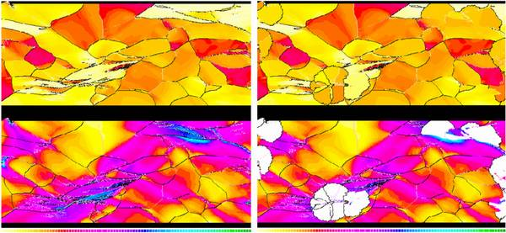
(enrich) “Re~crystallization”
process in which crystals in minerals change in size and composition

Slide 6
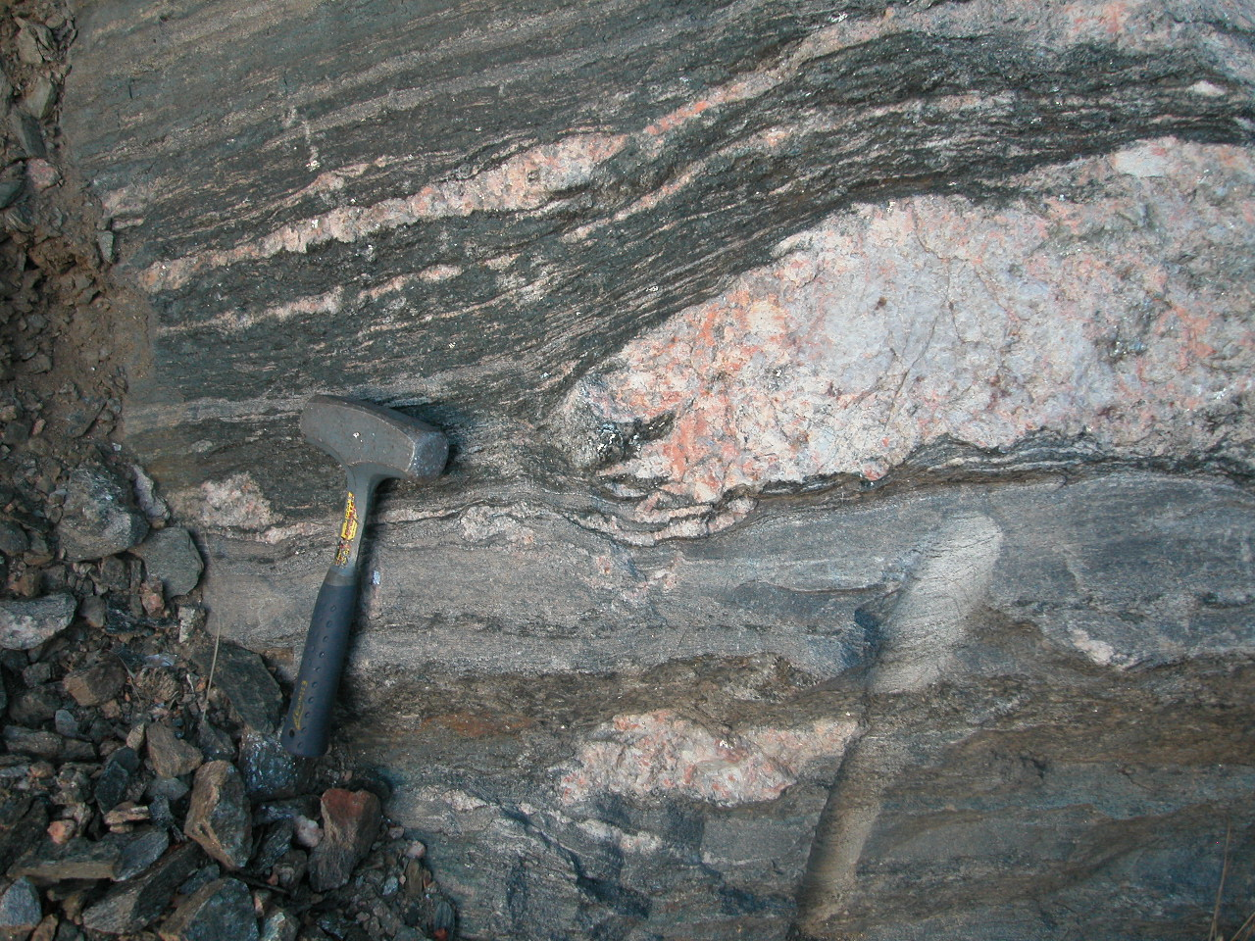
Igneous Intrusion

Slide 7
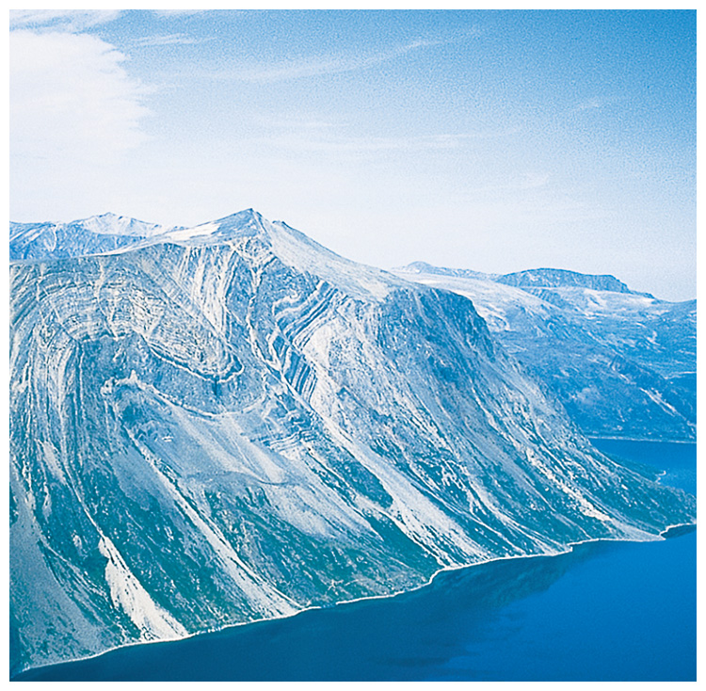
Metamorphism can be caused by force/pressure.
pressure
Labrador, Canada

Slide 8
Parent rock to metamorphic rock

Slide 9
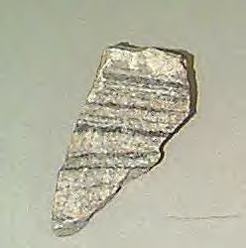
Classifying Metamorphic Rocks
1--Foliated
grains in parallel bands
ex:
slate (from shale)
schist (from phyllite)
gneiss (from granite)
2--Nonfoliated
grains arranged randomly
ex:
marble (from limestone)
quartzite (from sandstone)
Gneiss (foliated)

Slide 10
Parent rock to metamorphic rock (look at samples)
shale to slate
sandstone to quartzite
limestone to marble
Bituminous coal to Anthracite coal
Basalt to schist
granite to gneiss
Slate to schist
Schist to gneiss

